Slide 1

Green Pace
Security Policy Presentation
Developer: Edwin Mendoza

Slide 2

OVERVIEW: DEFENSE IN DEPTH
• Green Pace needs a repeatable security policy so secure development practices remain consistent as the development team grows.
• The policy standardizes 10 security principles, 10 C/C++ coding standards, encryption, Triple-A controls, automated analysis, and testing.
• Defense in depth combines secure coding, automated analysis, unit/integration testing, access control, encryption, logging, monitoring, and incident response.
• Security is continuous: controls are applied during planning, development, verification, release, detection, response, and improvement.

Slide 3
THREATS MATRIX
Threat matrix:
• Level 5 = critical/highest priority
• Level 4 = high
• Level 3 = moderate
• Level 2 = lower
• Priority reflects impact, likelihood, exploitability, and remediation urgency.
Likelihood / Impact | Level 2 | Level 3 | Level 4 | Level 5
Likely | STD-006 | STD-002, STD-007 | STD-003, STD-008, STD-009, STD-010 | STD-004, STD-005
Probable | — | STD-007 | STD-001, STD-009, STD-010 | —
Possible | STD-006 | STD-002 | STD-001, STD-008 | —
Unlikely | STD-006 | — | — | —
Immediate focus | — | STD-002, 007 | STD-001, 003, 008, 009, 010 | STD-004, 005

Slide 4
10 PRINCIPLES
Security principle | Coding standards aligned
1. Validate Input Data | STD-001, 002, 003, 004, 006, 008, 009
2. Heed Compiler Warnings | STD-001, 008
3. Architect and Design for Security Policies | Architecture overlay; supports all standards
4. Keep It Simple | STD-003, 005, 006, 010
5. Default Deny | STD-004, 007, 009
6. Principle of Least Privilege | STD-005, 007, 010
7. Sanitize Data Sent to Other Systems | STD-002, 003, 004, 008, 009
8. Practice Defense in Depth | STD-003, 005, 006, 007, 008, 009, 010
9. Effective Quality Assurance | STD-006, 007, 010
10. Adopt a Secure Coding Standard | STD-001 through STD-010

Slide 5
CODING STANDARDS
• Priority 1 — Level 5: STD-004 SQL Injection; STD-005 Memory Protection.
• Priority 2 — Level 4: STD-001 Data Type; STD-003 String Correctness; STD-008 Integer Overflow/Conversion; STD-009 Bounds/Container Access; STD-010 Resource Management/RAII.
• Priority 3 — Level 3: STD-002 Data Value; STD-007 Exceptions.
• Priority 4 — Level 2: STD-006 Assertions.
• Ranking system: address the highest-impact and most exploitable weaknesses first, then reduce moderate and lower-risk defects through the normal development cycle.

Slide 6
ENCRYPTION POLICIES
• At rest: encrypt sensitive, confidential, credential, and regulated data on persistent storage, databases, backups, and endpoints; centrally manage keys.
• In flight: require authenticated encryption in transit, such as modern TLS, across users, services, APIs, databases, and trust boundaries.
• In use: minimize sensitive data in memory, avoid unnecessary copies, and use protected execution and memory-access controls where practical.
• Goal: preserve confidentiality across the data lifecycle and make encryption configuration auditable.

Slide 7
TRIPLE-A POLICIES
• Authentication — verify users, services, and devices before protected resources or privileged functions are accessed; protect credentials and require approved authentication controls.
• Authorization — apply least privilege and default deny; enforce access decisions at the server or trusted enforcement point.
• Accounting — record logins, database changes, new users, access levels, and files accessed; protect logs from unauthorized modification.
• Triple-A answers: Who are you? What may you do? What did you do?

Slide 8
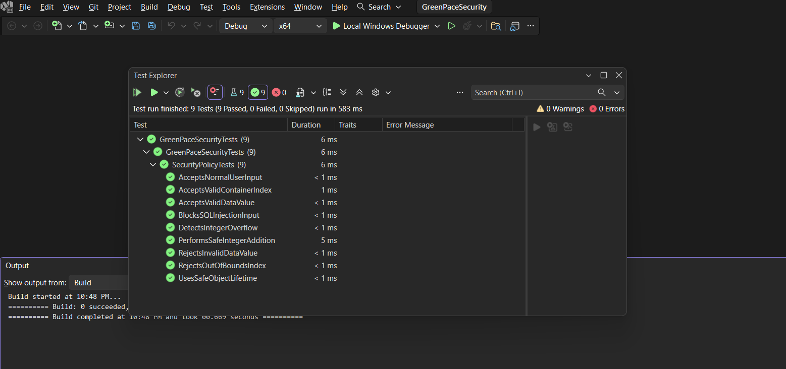
UNIT TEST 1 — DATA VALUE (STD-002-CPP)
• Vulnerability: invalid or out-of-range values can cause unsafe behavior.
• Negative: RejectsInvalidDataValue rejects -1 and 121.
• Positive: AcceptsValidDataValue accepts an in-range value.
• Result: PASS. Next step: add boundary, malformed-input, and fuzz tests.
Visual Studio Test Explorer — 9/9 passed

Slide 9
UNIT TEST 2 — SQL INJECTION (STD-004-CPP)
• Vulnerability: untrusted input may be interpreted as executable SQL.
• Negative: BlocksSQLInjectionInput rejects a SQL-injection-style payload.
• Positive: AcceptsNormalUserInput accepts normal user data.
• Result: PASS. Next step: test parameterized queries and add DAST/integration testing.
Visual Studio Test Explorer — 9/9 passed

Slide 10
UNIT TEST 3 — MEMORY PROTECTION (STD-005-CPP)
• Vulnerability: unsafe object lifetime can cause use-after-free defects.
• Test: UsesSafeObjectLifetime verifies safe ownership with std::unique_ptr.
• Result: PASS. The test avoids deliberately dereferencing freed memory because that is undefined behavior.
• Next step: add sanitizer and static-analysis coverage.
Visual Studio Test Explorer — 9/9 passed

Slide 11
UNIT TEST 4 — INTEGER OVERFLOW (STD-008-CPP)
• Vulnerability: arithmetic overflow can produce unsafe sizes or indexes.
• Negative: DetectsIntegerOverflow rejects INT_MAX + 1.
• Positive: PerformsSafeIntegerAddition verifies a safe calculation.
• Result: PASS. Next step: test multiplication and signed/unsigned conversions.
Visual Studio Test Explorer — 9/9 passed

Slide 12
UNIT TEST 5 — BOUNDS CHECKING (STD-009-CPP)
• Vulnerability: invalid indexes can cause out-of-bounds access.
• Negative: RejectsOutOfBoundsIndex rejects an index equal to vector size.
• Positive: AcceptsValidContainerIndex returns the expected record.
• Result: PASS. Next step: add empty-container, boundary, and fuzz cases.
Visual Studio Test Explorer — 9/9 passed

Slide 13
AUTOMATION SUMMARY
PLAN
CREATE
VERIFY
RELEASE
PREVENT/
DETECT
RESPOND
PREDICT
ADAPT
• CREATE: IDE secure-coding checks provide immediate feedback.
• VERIFY: compiler warnings, SAST, software composition analysis, unit/integration tests, and DAST/IAST act as CI gates.
• PRE-RELEASE: fuzzing and integration tests exercise input, memory, exception, and boundary cases.
• OPERATE: signed artifacts, runtime protections, logging, monitoring, penetration testing, and security orchestration continue defense in depth.

Slide 14
TOOLS
  • Compiler: catches syntax, type, and warning-level defects before code advances.
• SAST: scans source for insecure patterns and CERT violations.
• Unit tests: verify security behavior repeatedly in CI.
• DAST/IAST: exercise the running application and trust boundaries.
• Fuzzing: supplies unexpected and malformed inputs.
• Examples: Microsoft C++ Unit Test Framework, Clang Static Analyzer, PVS-Studio, Klocwork, CodeSonar, Parasoft C/C++test, and Polyspace Bug Finder.
• Dependency/SCA tools identify vulnerable third-party components; security gates block high-risk findings or failed required tests.

Slide 15
RISKS AND BENEFITS
• ACT NOW — Benefits: reduce exploitable defects earlier, make security repeatable, create audit evidence, and lower the cost of fixing defects before production.
• ACT NOW — Costs: training, CI/CD integration, false positives, and remediation work can slow short-term delivery.
• WAIT — Risks: vulnerabilities remain available for exploitation; technical debt grows; remediation becomes more disruptive after release.
• Highest urgency: STD-004 SQL Injection and STD-005 Memory Protection are Level 5. Level 4 standards follow next.
• Mitigation: automate high-value checks, tune false positives, track exceptions, and make security gates proportional to risk.

Slide 16
RECOMMENDATIONS
    • Close the gap between policy and evidence by retaining unit-test results, SAST/DAST findings, exceptions, and remediation records.
• Expand testing into integration, fuzzing, DAST/IAST, and sanitizer-based memory testing.
• Enforce secure coding standards as CI/CD gates so high-risk violations cannot reach release without remediation or an approved exception.
• Strengthen dependency and supply-chain controls with software composition analysis and signed release artifacts.
• Review the policy at least annually and after major technology, regulatory, or threat changes.

Slide 17
CONCLUSIONS
• Green Pace should continue treating security as a lifecycle responsibility rather than a final review.
• Continuously enforce the 10 C/C++ standards and use CERT C/C++ as the secure-coding foundation.
• Use defense in depth: validation, least privilege, sanitization, encryption, automated analysis, testing, logging, monitoring, and incident response.
• Future focus: increase automated detection, expand negative/fuzz testing, strengthen supply-chain controls, and use lessons from recurring defects to update the policy.
• Goal: measurable, repeatable, and auditable secure development.

Slide 18
REFERENCES
• Green Pace Security Team. (2026). Green Pace security policy (Project One completion). Internal course document.
• Microsoft. (2026). Write unit tests for C++ DLLs — Visual Studio. https://learn.microsoft.com/en-us/visualstudio/test/how-to-write-unit-tests-for-cpp-dlls
• OWASP Foundation. (2026). SQL Injection Prevention Cheat Sheet. https://cheatsheetseries.owasp.org/cheatsheets/SQL_Injection_Prevention_Cheat_Sheet
• OWASP Foundation. (2026). Query Parameterization Cheat Sheet. https://cheatsheetseries.owasp.org/cheatsheets/Query_Parameterization_Cheat_Sheet
• SEI. (2026). CERT C++ Coding Standard. https://wiki.sei.cmu.edu/confluence/display/cplusplus
• SEI. (2026). Automated Detection — CERT C++ Coding Standard. https://wiki.sei.cmu.edu/confluence/pages/viewpage.action?pageId=88046857

